Slide 1
Subject: Electricity Laboratory
Experiement 1: Ohm’s Law
Al-Karkh University of Science
College of Science
Department of Medical Physics
Prepared by:
Dr. Nihad K Ali
Zaineb Faleh Nazal

Slide 2
Introduction
When a battery is connected to a circuit consisting of wires and other circuit elements like resistors and capacitors, voltages can develop across those elements and currents can flow through them. In this lab we will investigate three types of circuits: those with only resistors in them and those with resistors and either capacitors (RC circuits) or inductors (RL circuits). We will confirm that there is a linear relationship between current through and potential difference across resistors (Ohm’s law: V = IR).

Slide 3
Objective of the experiment:
Realization of Ohm’s law experimentally (finding the linear relation between voltage and current passing through a liner resistance).
Measuring the resistance used in the experiment.

Slide 4
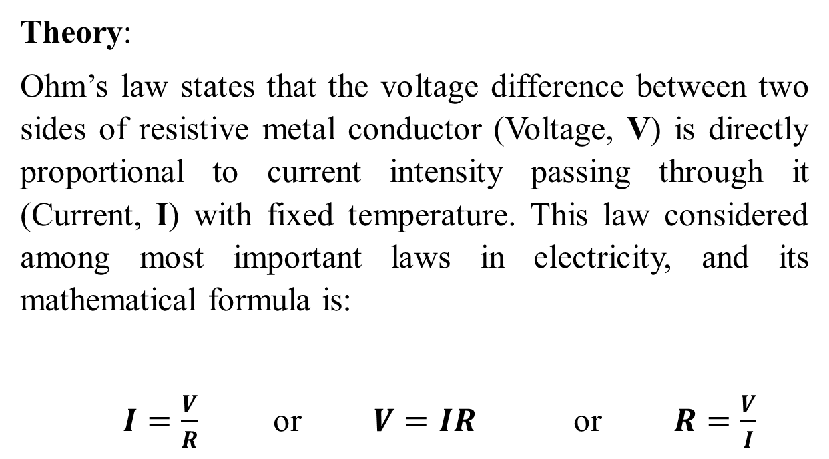
Theory:
Ohm’s law states that the voltage difference between two sides of resistive metal conductor (Voltage, V) is directly proportional to current intensity passing through it (Current, I) with fixed temperature. This law considered among most important laws in electricity, and its mathematical formula is:
$I=\frac{V}{R}$ or $V=IR$ or $R=\frac{V}{I}$

Slide 5
Instruments:
DC power supply.
Small resistor.
Voltmeter.
Ammeter.
Connection wires.

Slide 6
Methods:
Connect the circuit as shown in Figure 1.
Make sure the circuit is connected correctly by observing the Ammeter reading.
Record number of readings for current (I) by changing the voltage each time, as shown in table below:
Draw the relation between current (I) and voltage (V) from the reading you recorded, as shown in Figure 2.
Find the slope value from the relation :
Slope=△I△V
Calculate the current value through the relation:
R=1Slope
Which should be equal to the fixed resistant used in the experiment.
V (volt)
I (amp)

